Slide 1
BZ350 Recitation Week 11
T.A. info:
Chris deRoux (day-ROO)
Any/all pronouns
Chris.deRoux@colostate.edu
Office Hours: Every Friday 10AM-12PM in Bio 355
Itinerary:
Announcements
Transcription Review
Splicing Review
Sample Problems

Slide 2
Announcements
Problem Set 10: Due Monday April 7th.

Slide 3
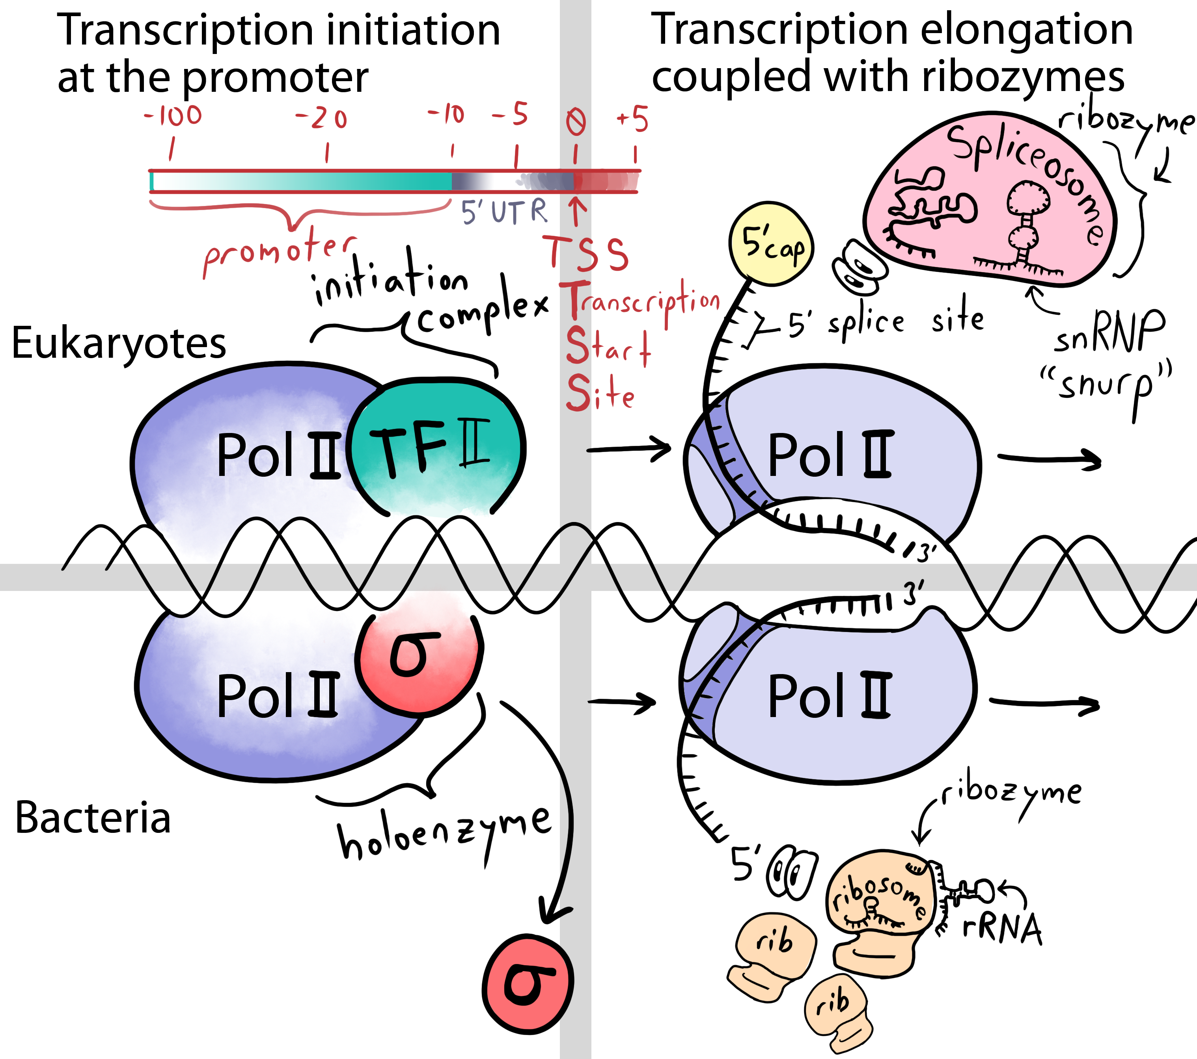

Slide 4
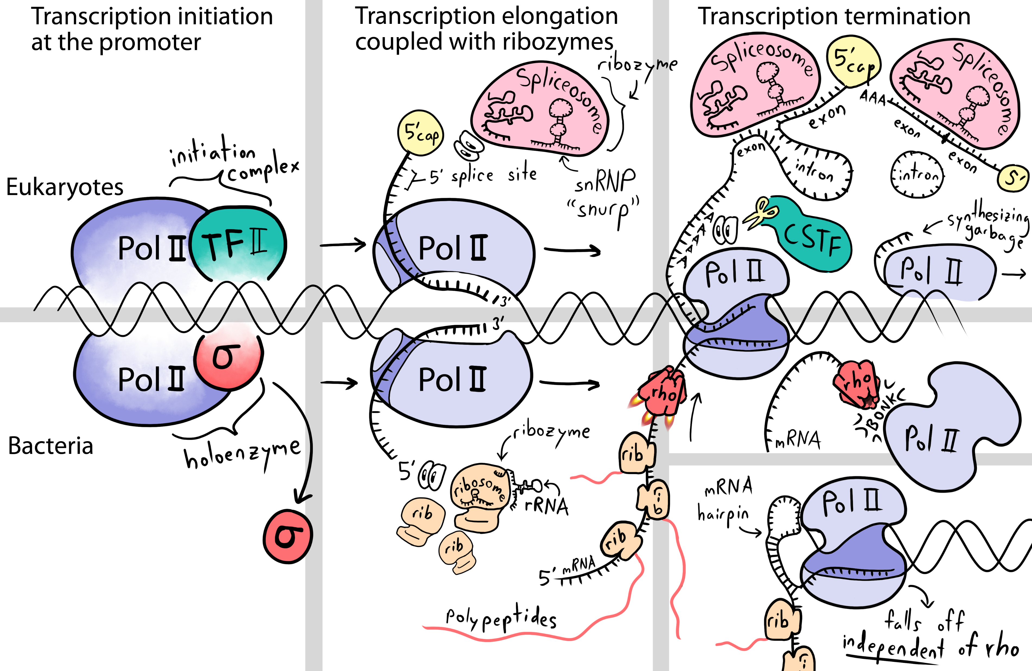

Slide 5
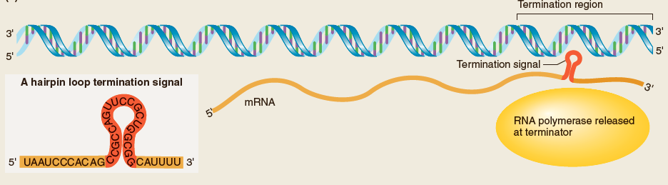
Bacterial Termination: Depends on hairpin loops.
Terminators are RNA sequences that signal the end of transcription
Two kinds of terminators in bacteria: extrinsic (require rho factor) and intrinsic (don’t require additional factors)
Usually form hairpin loops (intramolecular H-bonding)

Slide 6
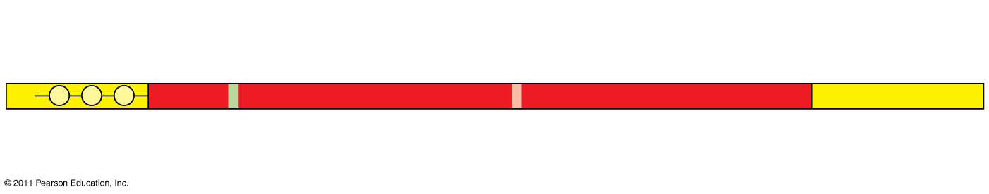
Eukaryotic Termination: Depends on polyadenylation signal.
Enzymes in the eukaryotic nucleus modify pre-mRNA (RNA processing) before the genetic messages are dispatched to the cytoplasm
Each end of a pre-mRNA molecule is modified:
The 5′ end receives a modified nucleotide 5′ cap
The 3′ end gets a poly-A tail
Protein-coding segment
Polyadenylation signal
5′
3′
G
P
P
P
AAUAAA
AAA
…
AAA
Cap
5′
Start codon
Stop codon
5′
UTR
3′
UTR
Poly-A tail
Notes:
6

Slide 7
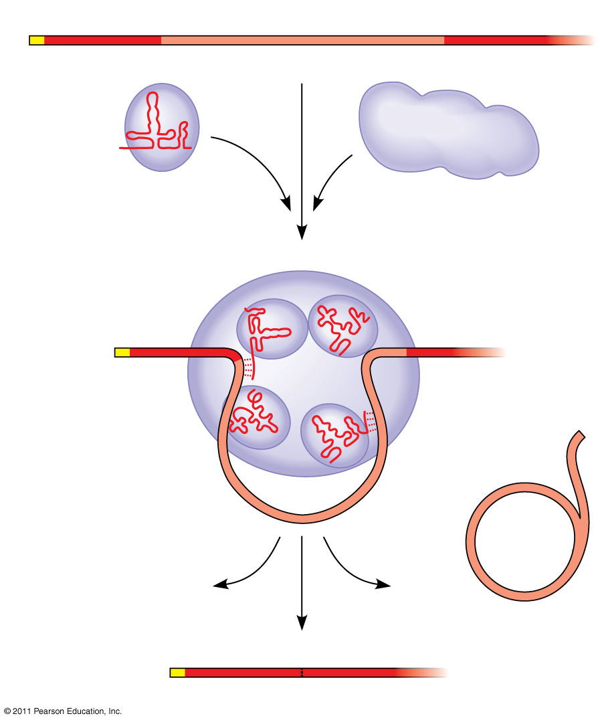
RNA transcript (pre-mRNA)
Spliceosomes
5′
Exon 1
Intron
Exon 2
Protein
Other proteins
snRNA
In some cases, RNA splicing is carried out by spliceosomes
Spliceosomes consist of a variety of proteins and several small nuclear ribonucleoproteins (snRNPs) that recognize the splice sites
snRNPs
Spliceosome
5′
Spliceosome components
Cut-out intron
mRNA
5′
Exon 1
Exon 2
Notes:
Spiceosome
Small nuclear ribonucleoproteins (snRNPs) + other proteins bind mRNA
clip introns and rejoin exons
(draw)

Slide 8
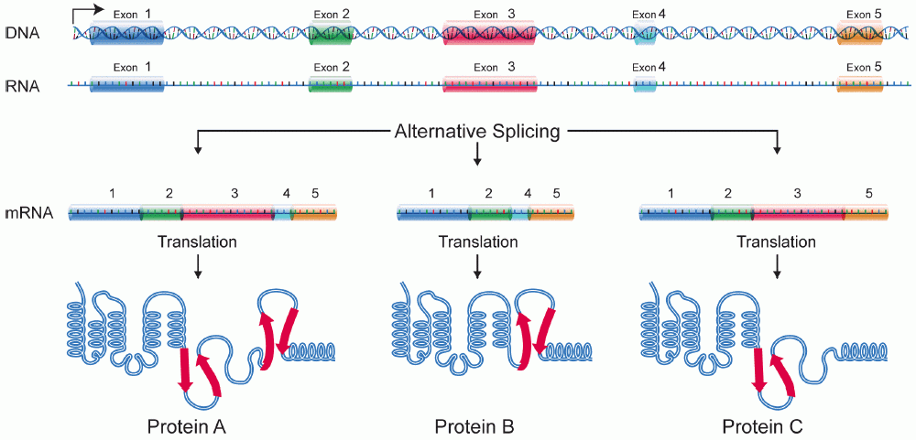
Why do Eukaryotes have Introns?

Slide 9
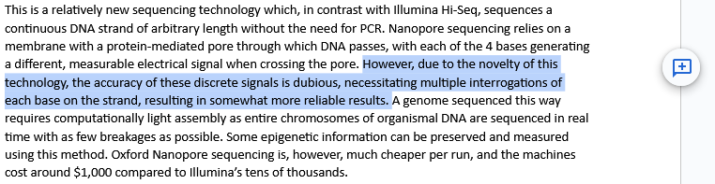
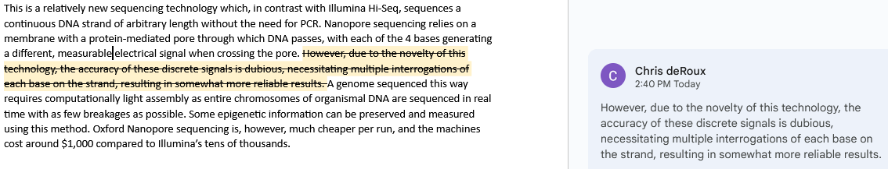
Preserving genetic information which may come in handy again.

Slide 10
You are studying the effects of mutations on the expression of a human protein-encoding gene in liver cells. The gene has one intron that is 450 nucleotides long. After this intron is removed from the pre-mRNA, the mRNA transcript is 1100 nucleotides long. Diploid somatic cells have two copies of this gene. Consider the following individuals:
Individual 1: Normal individual with no mutations in this gene.
Individual 2: Homozygous for a deletion that removes the -10 to -100 region of the gene.
Individual 3: Heterozygous in which one gene is normal and the other gene has a deletion that removes the -10 to -100 region.
Individual 4: Homozygous for a mutation that introduces an early stop codon into the middle of the coding sequence of the gene.
Individual 5: Homozygous for a ten-nucleotide deletion that removes the GT sequence at the 5′ splice site.
For each individual answer a) would there be expression of the gene? b) If so, what would be the length of the expressed transcripts? c) Would a functional protein be produced?

Slide 11
Individual 1: The 1,100-nucleotide mRNA would be produced from a normal individual. A normal amount of mRNA is produced in this individual
Individual 2: A deletion that removes the –10 to –100 region results in the deletion of its promoter region that is important for RNA polymerase II binding. A gene with this mutation will not be transcribed. This individual has a deletion of this region in both copies of the gene and does not produce any transcript.
Individual 3: This individual heterozygous for this deletion would produce roughly half as much of the 1,100-nucleotide transcript as compared to a normal individual.
Individual 4: A nonsense codon would not have an affect on transcription; it affects only translation. So the individual 4 with this mutation would produce a normal amount of the 1,100-nucleotide transcript.
Individual 5: A mutation that removed the splice donor site (5’ splice site) would prevent the splicing of pre-mRNA. Therefore, this individual would produce a normal amount of 1,540-nucleotide transcript (1,550 minus 10).

